Slide 1

Adidas US Sales Analysis
The "Adidas US Sales Analysis" project is a comprehensive exploration of Adidas' sales performance in the United States. Leveraging a dataset that includes crucial information about retailers, products, sales methods, and financial metrics, this analysis delves into various aspects of Adidas' operations. The project is divided into three key sections:

Slide 2
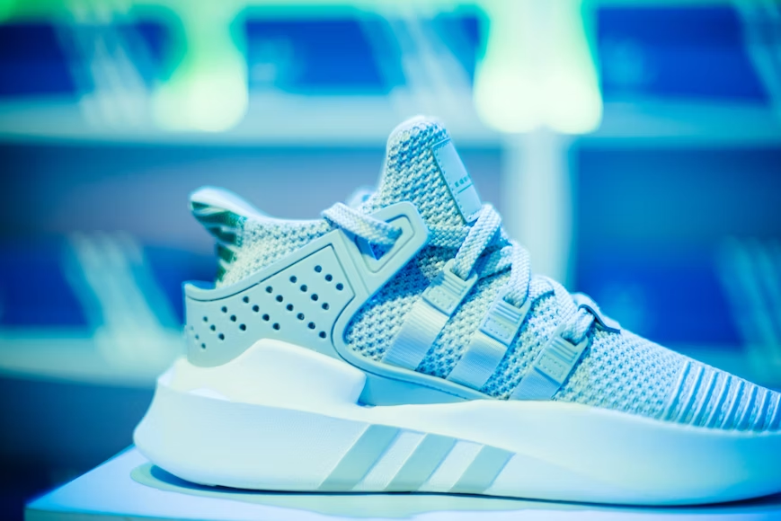
------------
Problem Statement
You're tasked with analysing Adidas' sales data in the US. The primary goal of your analysis is to gain insights into sales performance and trends across different products, retailers, and sales methods. Your analysis will inform business strategies, including product offerings, retailer relationships, and sales channels.

Slide 3
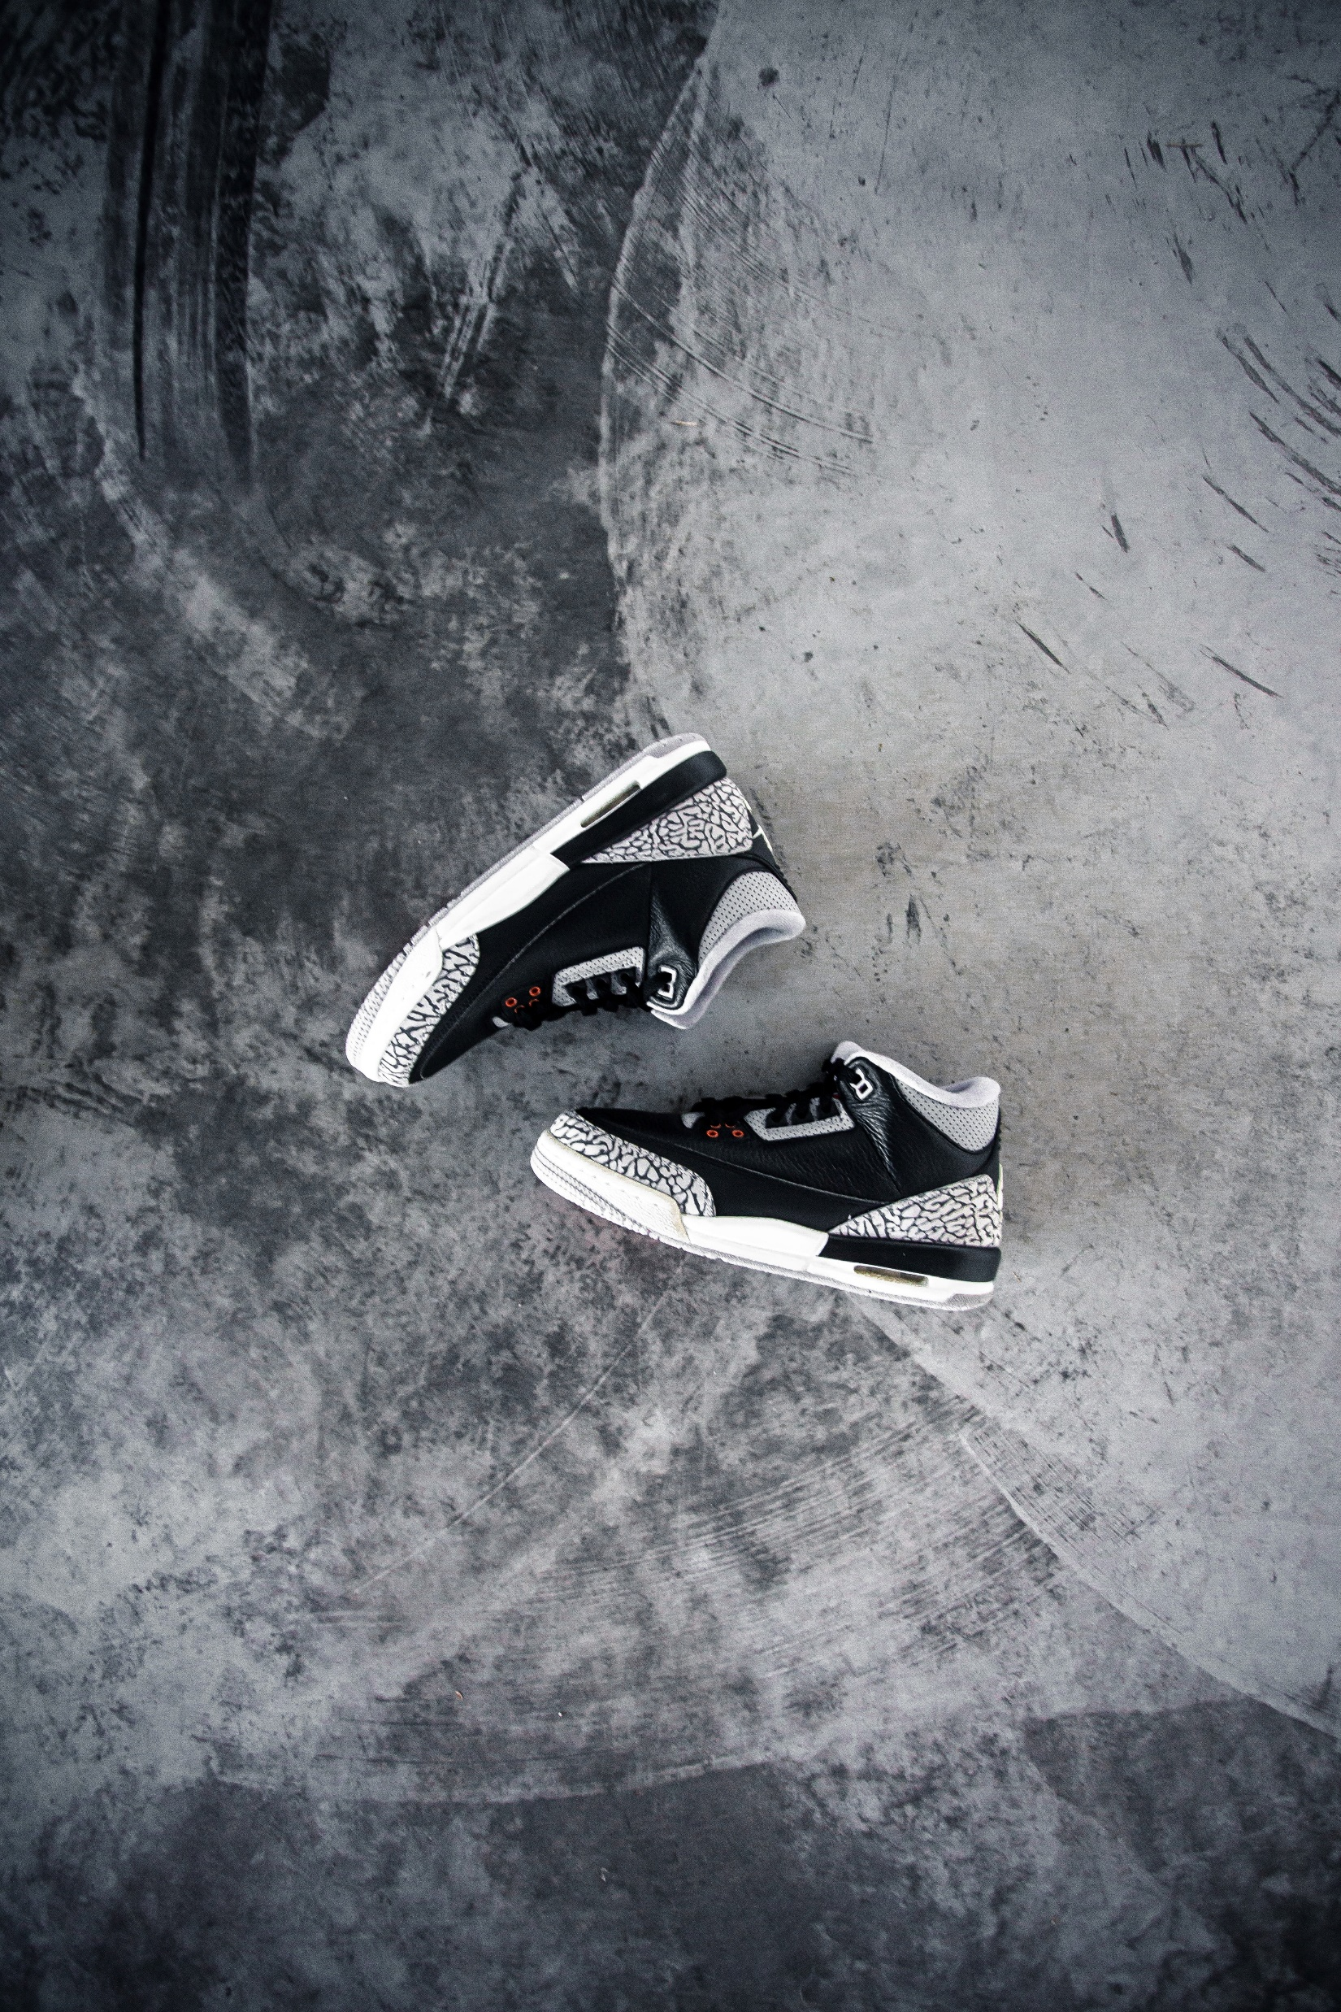
HYPOTHESIS
Product Analysis
001
Null Hypothesis :
There is no significant difference in total sales across different sales methods for each product category
Alternative Hypothesis : There is a significant difference in total sales across different sales methods for each product category.
002
003

Slide 4

HYPOTHESIS
001
Deep Insight
Null Hypothesis :
The choice of retailer does not significantly impact total sales.
Alternative Hypothesis : The choice of retailer significantly impacts total sales.
002
003

Slide 5

HYPOTHESIS
001
Trend Insight
Null Hypothesis :
There is no significant month-over-month change in units sold or sales for Adidas..
Alternative Hypothesis : There is a significant month-over-month change in units sold or sales for Adidas..
002
003

Slide 6
5050
5050
5050
5050
5050
5050
3
6
5
2
1
4
What are the key periods when Adidas experiences spikes or declines in sales?
How do sales vary by product category, and what is the most popular sales method for each category?
Which retailer contributes the most to Adidas' US sales, and what products are driving their sales?
How have sales, profit, and operating margin changed over time on a month-over-month (MOM) basis?
Are there specific states that significantly contribute to Adidas' sales, and if so, which products are popular in these states?
Is there a correlation between the region and the total sales or profitability?
Research Questions

Slide 7
5050
5050
5050
5050
5050
5050
3
1
6
2
4
5
What are the key periods when Adidas experiences spikes or declines in sales?
Are there specific states that significantly contribute to Adidas' sales, and if so, which products are popular in these states?
How do sales vary by product category, and what is the most popular sales method for each category?
How have sales, profit, and operating margin changed over time on a month-over-month (MOM) basis?
Is there a correlation between the region and the total sales or profitability?
Which retailer contributes the most to Adidas' US sales, and what products are driving their sales?
Research Questions

Slide 8
5050
5050
5050
5050
5050
5050
1
2
6
5
4
3
Are there specific states that significantly contribute to Adidas' sales, and if so, which products are popular in these states?
How have sales, profit, and operating margin changed over time on a month-over-month (MOM) basis?
How do sales vary by product category, and what is the most popular sales method for each category?
Which retailer contributes the most to Adidas' US sales, and what products are driving their sales?
Is there a correlation between the region and the total sales or profitability?
What are the key periods when Adidas experiences spikes or declines in sales?
Research Questions

Slide 9
5050
5050
5050
5050
5050
5050
1
2
3
6
4
5
Are there specific states that significantly contribute to Adidas' sales, and if so, which products are popular in these states?
How have sales, profit, and operating margin changed over time on a month-over-month (MOM) basis?
What are the key periods when Adidas experiences spikes or declines in sales?
How do sales vary by product category, and what is the most popular sales method for each category?
Is there a correlation between the region and the total sales or profitability?
Which retailer contributes the most to Adidas' US sales, and what products are driving their sales?
Research Questions

Slide 10
5050
5050
5050
5050
5050
5050
1
2
3
4
6
5
Are there specific states that significantly contribute to Adidas' sales, and if so, which products are popular in these states?
How have sales, profit, and operating margin changed over time on a month-over-month (MOM) basis?
What are the key periods when Adidas experiences spikes or declines in sales?
Is there a correlation between the region and the total sales or profitability?
How do sales vary by product category, and what is the most popular sales method for each category?
Which retailer contributes the most to Adidas' US sales, and what products are driving their sales?
Research Questions

Slide 11
5050
5050
5050
5050
5050
5050
1
2
3
4
5
6
Are there specific states that significantly contribute to Adidas' sales, and if so, which products are popular in these states?
How have sales, profit, and operating margin changed over time on a month-over-month (MOM) basis?
What are the key periods when Adidas experiences spikes or declines in sales?
Is there a correlation between the region and the total sales or profitability?
Which retailer contributes the most to Adidas' US sales, and what products are driving their sales?
How do sales vary by product category, and what is the most popular sales method for each category?
Research Questions

